Slide 1
Diwali Sales Analysis 🪔
Presented By :
Ayush Srivastava, Gaurav Tiwari & Pranjal Mishra

Slide 2


Introduction
Diwali Sales data is analyze for small businesses overview.
Method of exploring and analyzing data recorded over a set period of time.
This analysis is used to make future predictions.
Datasets :
Amazon Great Indian Sales
Flipkart Big Billion Days Sale
Walmart Sales

Slide 3



Problem Statement
Expensive
Lack of Insights
High Data and Time usage

Slide 4

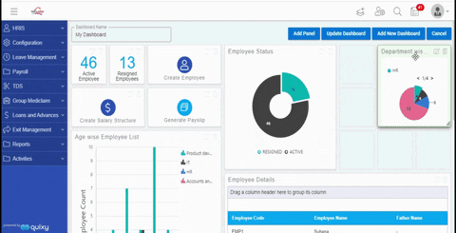
Objective & Scope
Our objective is to make
analysis for small businesses.
We will be creating simple & interesting report.
Our project will help the user and business.

Slide 5
Proposed System
Dataset
Data Preprocessing
Data Analysis
Data
Visualization
Display
Result

Slide 6
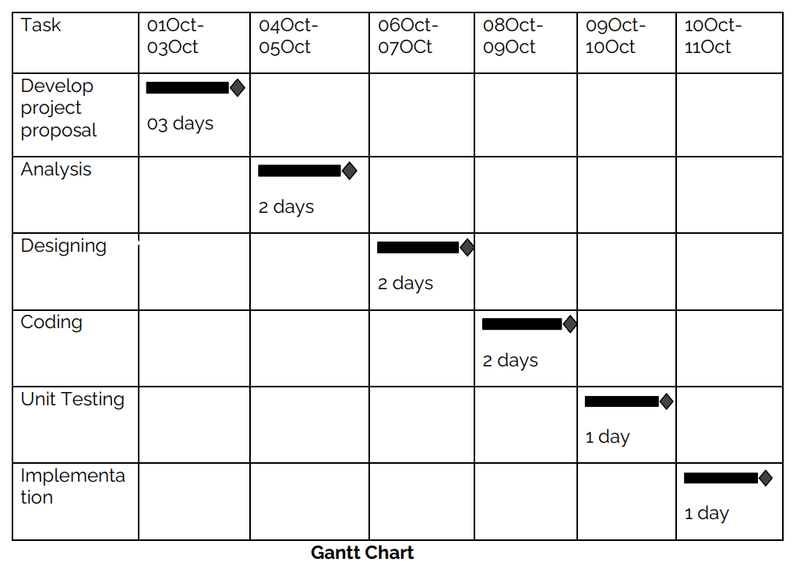
Planning Steps

Slide 7
Hardware Requirements
Client Side
Processor | Dual Core or above
RAM | 1 GB
Disk space | 150 GB
Screen Resolution | 1080p or less
Others | Keyboard, mouse, Internet Connection, Mobile
Server Side
Processor | Dual Core or above
RAM | 1 GB
Disk space | 150 GB
Screen Resolution | 1080p or less
Others | Keyboard, mouse, Internet Connection

Slide 8


Software Requirements
Client Side
● Web Browser (Google Chrome, Firefox, Edge or above) ● Windows 7 or above / Linux / Android / IOS
Server Side
● Web Browser (Google Chrome, Firefox, Edge or above)
● Windows 7 or above / Linux / Android / IOS
● VScode
● Python 3.9
● Html, CSS, Bootstrap
● JavaScript supported browser

Slide 9
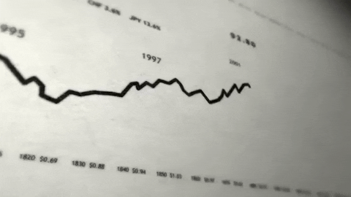
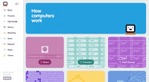

Modules
03 View Display
01 Data Pre-processing
02 Analysis & Visualization
Give report.
Provide flexibility.
Create or upload file.
Checking and removing incorrect data.
Format Data.
Data Analysis.
Finds Insights
Graphical representation.

Slide 10
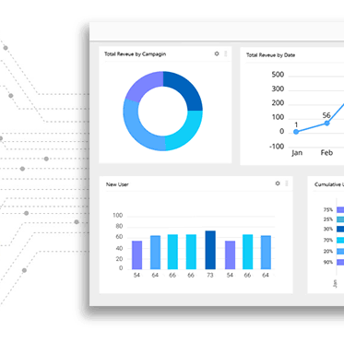
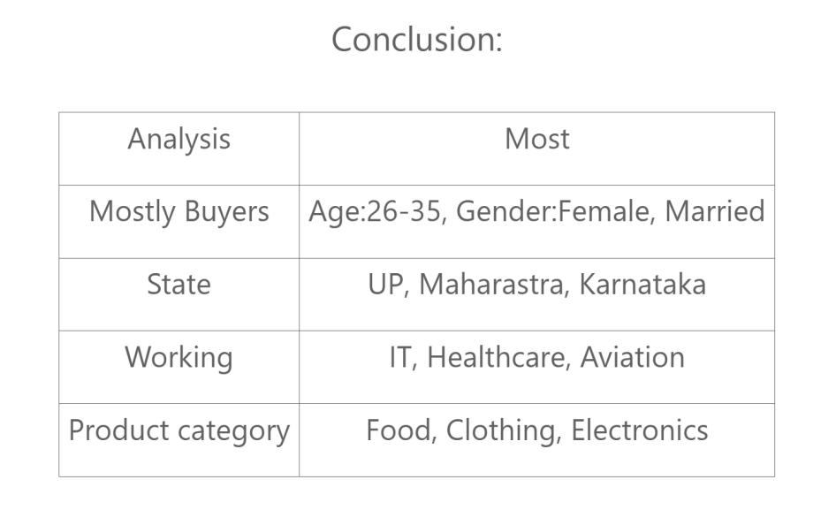
Conclusion
We are creating an analysis that insights the Diwali sales data based on your previous sales data.
It helps small businesses, whole sellers, and Startups.

Slide 11
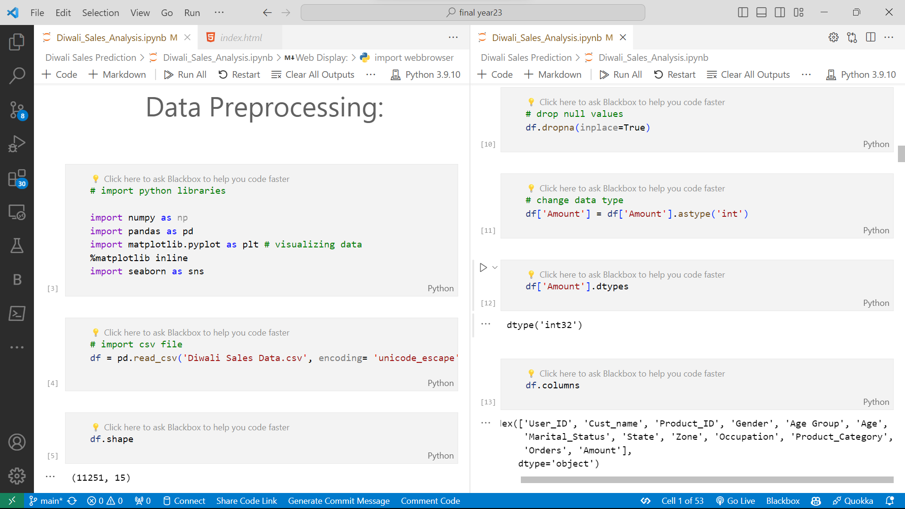

Slide 12
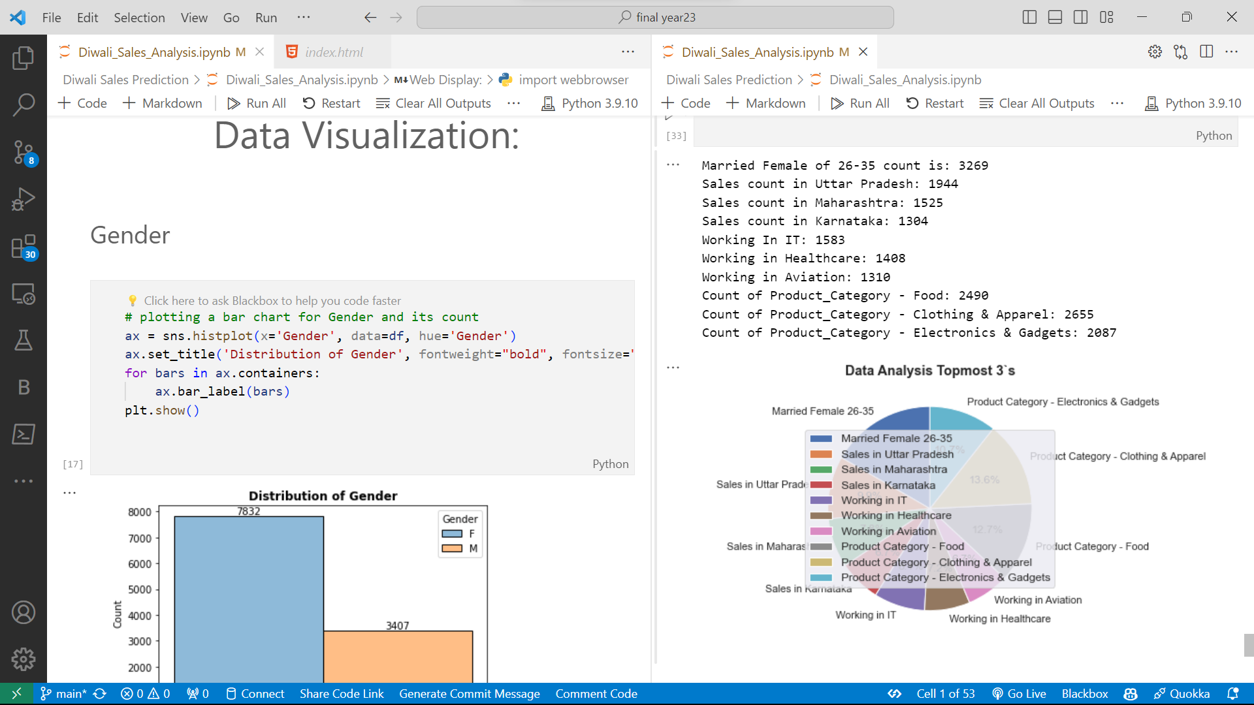

Slide 13
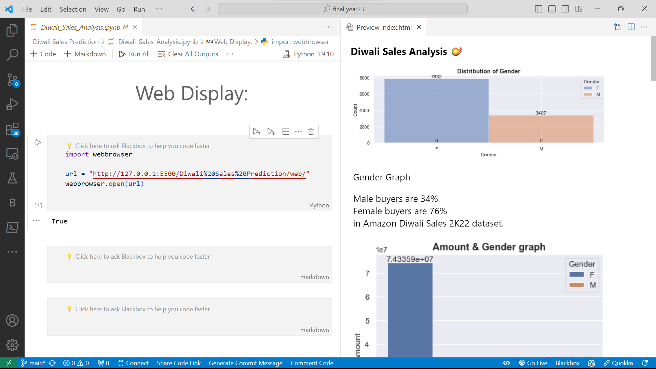

Slide 14
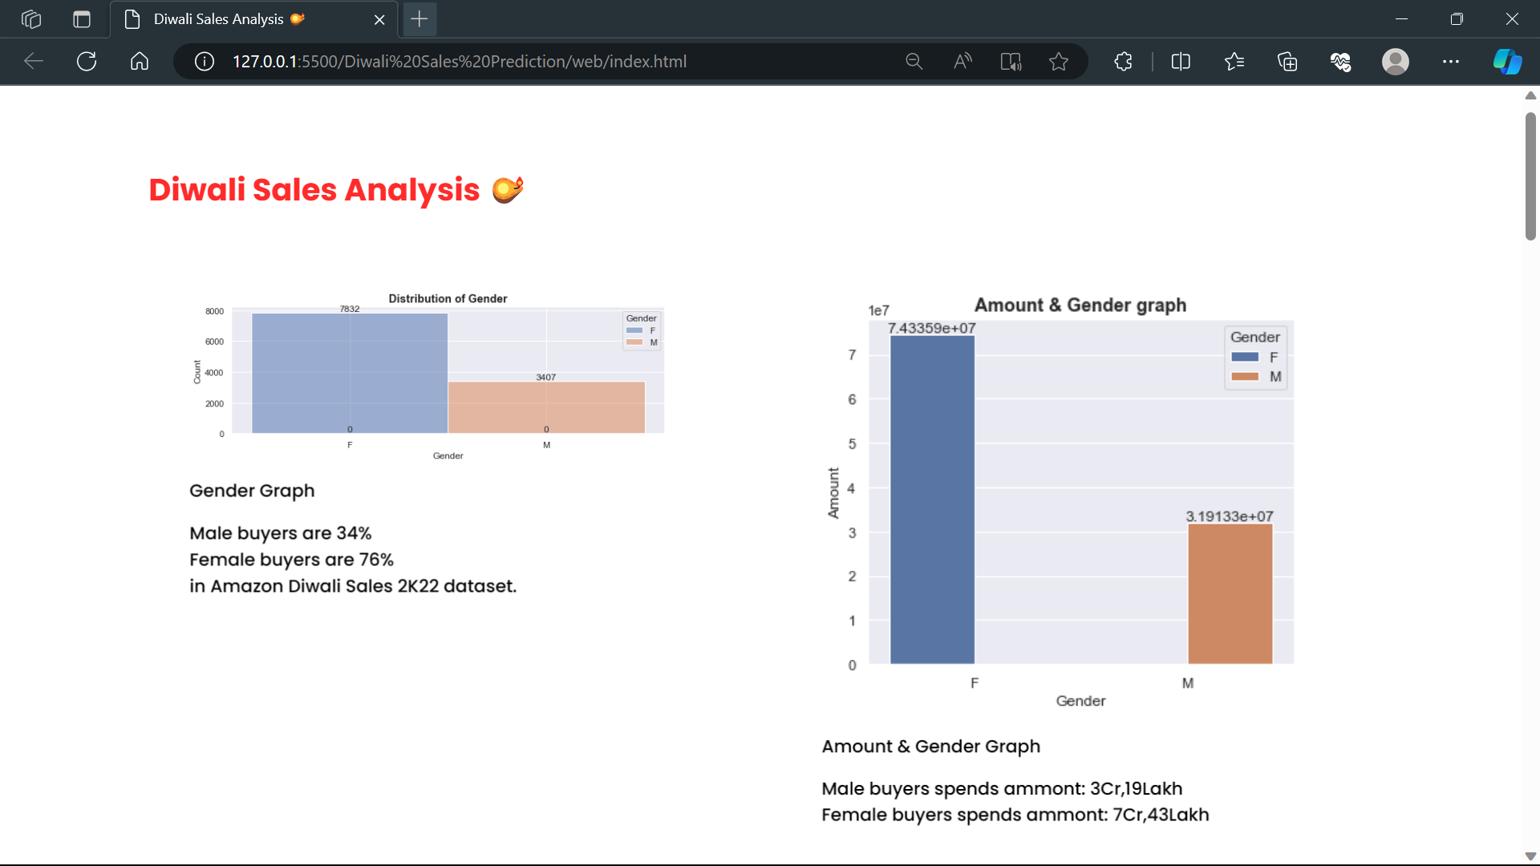
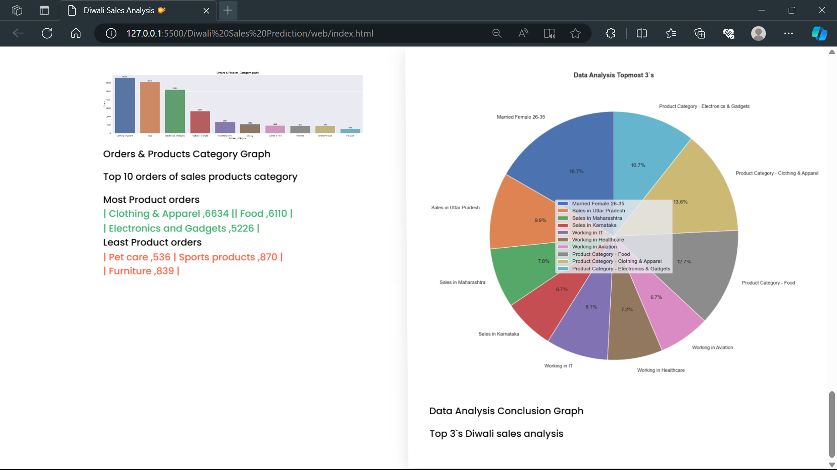

Slide 15

Diwali Sales Analysis 🪔
THANK YOU
Project Link 🔗

